Slide 1
Principal Component Analysis (PCA)
Lesson 19.3

Slide 2
Class Objectives
By the end of this lesson, you will be able to:
Explain PCA and how it can be used to reduce dimensionality in data.
Conceptualize how PCA relates to K-means and other applications in machine learning.
Use PCA to reduce the number of features in an unsupervised learning setting.

Slide 3
Notes:
1. Instructor Do: Welcome the Class (5 minutes)

Slide 4
Activity: Warm-Up
In this activity, you will standardize global currency data, and then segment it into three clusters.
20 Minutes
Notes:
2. Student Do: Warm-Up (20 minutes)

Slide 6
Notes:
3. Instructor Do: Review Warm-Up (15 minutes)

Slide 7
Introduction to PCA
Notes:
4. Instructor Do: Introduction to PCA (30 min)

Slide 8
Visualizing High-Dimensional Space

Slide 9
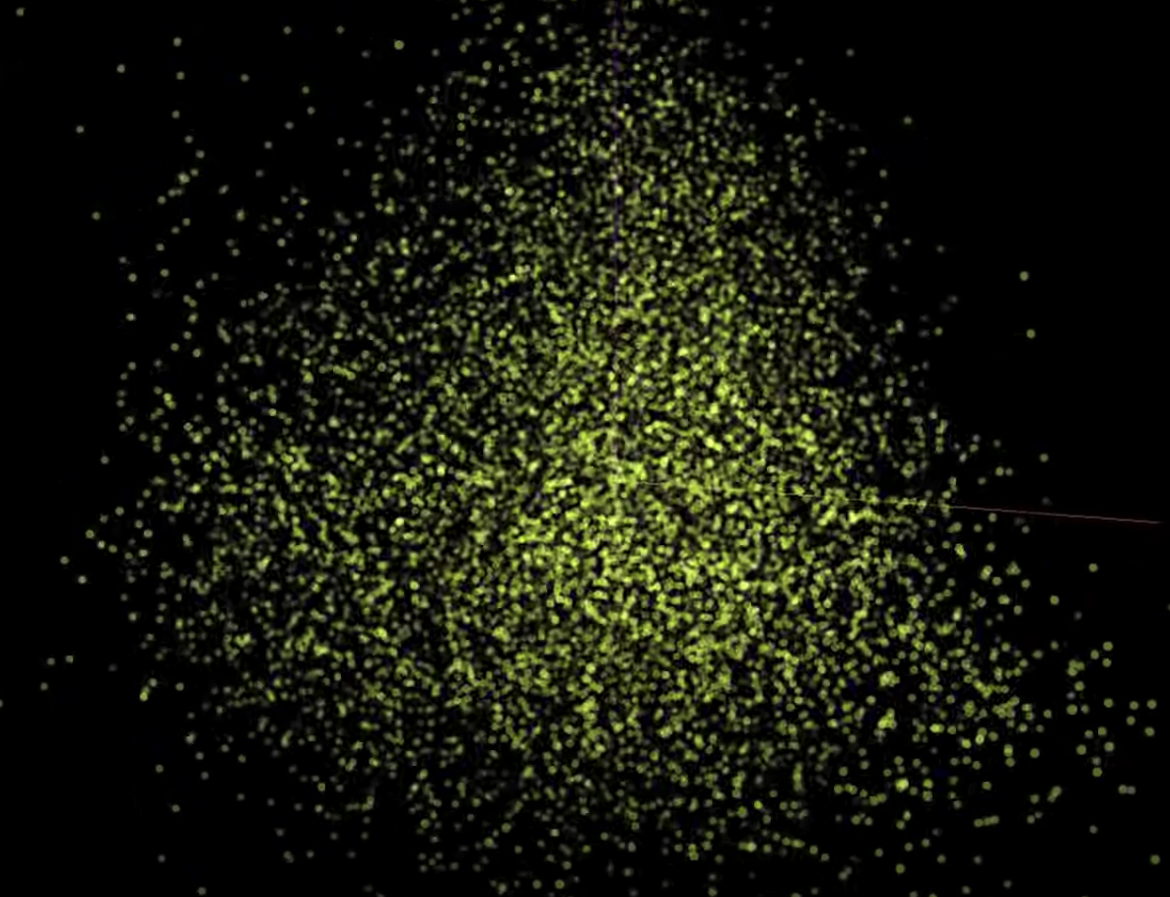
Introduction to PCA
Some of these datasets displayed are very large, with thousands (or more!) columns.
For some machine learning algorithms, this high dimensionality can become a problem.
https://experiments.withgoogle.com

Slide 10
What if we could reduce the size of the dataset while preserving as much useful information as possible?

Slide 11
Introduction to PCA
The principal component analysis algorithm, or PCA, works because all data has variability; variation contains useful information.
PCA 1st dimension
By keeping only the most common variation across the dataset, we can reduce the size of our dataset but still maintain a variety of useful features.
PCA 2nd dimension
pc2
pc 1
Notes:
shutterstock_398469061

Slide 12
Introduction to PCA
PCA is a statistical technique that we can use to streamline the machine learning process when too many factors exist in the data.
PCA reduces the number of factors by transforming a large set of features into a smaller one that contains MOST of the information of the original, larger dataset.
PCA is a dimensional-reduction method that looks at all the dimensions (or data columns) in a dataset, which:
Analyzes the weight of their contribution to the variance in the dataset.
Reduces variables to a smaller set of dimensions that still contains as much of the information, or the maximum variance, of the original dataset as possible.

Slide 13
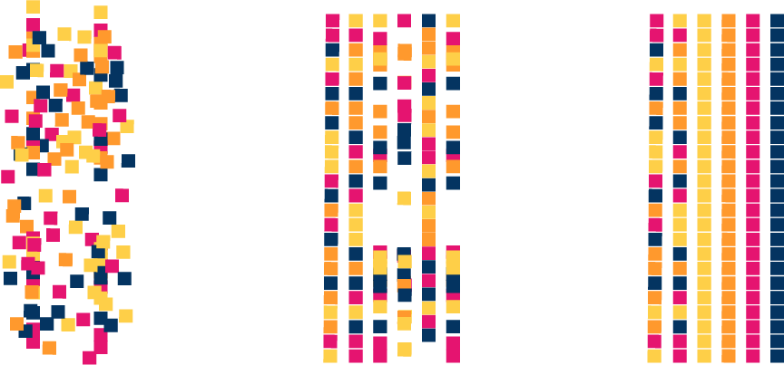
Introduction to PCA
Reducing the number of factors, or dimensional reduction, comes at the expense of some accuracy, but the goal is to trade a little accuracy for simplicity.
Notes:
shutterstock_398469061

Slide 14

The goal of PCA is simple:
Reduce the number of factors in a dataset while preserving as much of the information from the original dataset as possible.
Notes:
shutterstock_1951890379

Slide 15
Introduction to PCA

Slide 17
Activity: Segmenting with PCA
In this activity, you will use your knowledge of PCA to reduce the dimensionality of the customers DataFrame from the previous activity, and then compare that result to the segmentation of the data by using all the factors.
25 Minutes
Notes:
5. Student Do: Segmenting with PCA (25 min

Slide 18
Activity: Segmenting with PCA
Using the starter code and the customer data provided, perform the following steps:
Reduce the factors to only two dimensions by using PCA.
Determine the optimal value for k by using the PCA DataFrame.
Segment the data by using the K-means algorithm and the optimal value for k.
Segment the preprocessed customer DataFrame by using the K-means algorithm and the same value for k.
Compare the segmentation results.

Slide 19
Notes:
6. Instructor Do: Review Segmenting with PCA (20 minutes)

Slide 20
Notes:
3. Instructor Do: Review Warm-Up (15 minutes)

Slide 22
Activity: Energize Your Stock Clustering
In this activity, you will:
Strengthen your ability to reduce the number of features in your model by using PCA.
Cluster both standardized data and principal components into various clustering algorithms, and then compare the results.
30 Minutes

Slide 23
Notes:
9. Instructor Do: Review Energize Your Stock Clustering (20 minutes)

Slide 24
Notes:
3. Instructor Do: Review Warm-Up (15 minutes)

Slide 25
Structured Review

